Slide 1
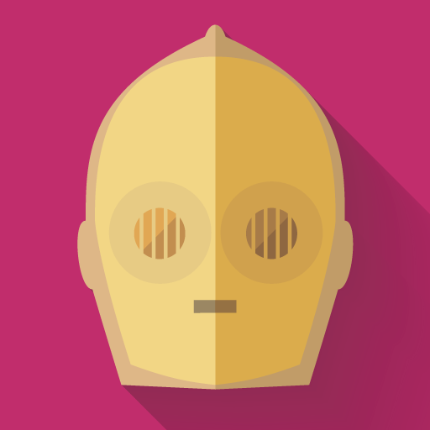

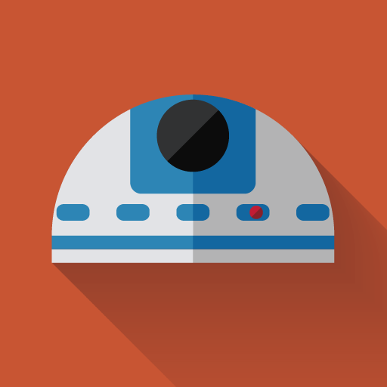



CI-droid
RabbitMq
CI-droid-tasks-consumer
PullRequest events
CI-droid
Webhook
Instance 1
GitHub
GitHub events
Instance 2
Push on default branch events
Instance 3
Action to perform on N files in N repos
CI-droid
actions
Action to perform on single file
Swagger / Postman / UI
Instance n
Notes:
Icons from http://www.iconarchive.com/show/starwars-longshadow-flat-icons-by-creativeflip.html

